Slide 2
Custom Image Classification Tutorial Building domain-specific image classifiers using Deep Learning and Transfer Learning with Microsoft ML Server
Mario Inchiosa, Principal Software Engineer
Bob Horton, Senior Data Scientist
Vanja Paunić, Data Scientist II
Tomas Singliar, Senior Data Scientist
Jing Chang, Senior Software Engineer
https://github.com/Azure/MLADS2017ML

Slide 3
Session Goals
Participants will learn how to use pre-trained deep learning models in Microsoft ML Server to generate features that can be used in traditional machine learning approaches.
Participants will learn how to run these types of featurization at scale.
Participants will learn how to use an active learning process to build more accurate classifiers by selecting additional training examples
Notes:
This slide is required. Do NOT delete. This should be the first slide after your Title Slide.
This slide should describe what your goals are for this session. This information lets your audience know what you are trying to accomplish with your talk or tutorial—ie, what value will attendees get by investing 25 minutes or 2 hours of their time listening to you.
You should not spend more than 1 minute presenting this slide.
General examples of session goals could be (you will have to create your own specific goals):
Introduce a new technique or approach to solve a customer problem
Compare two approaches and explain why one is superior
Describe a project and the learnings that audience members can apply from it
Teach audience members how to use a specific technology

Slide 4
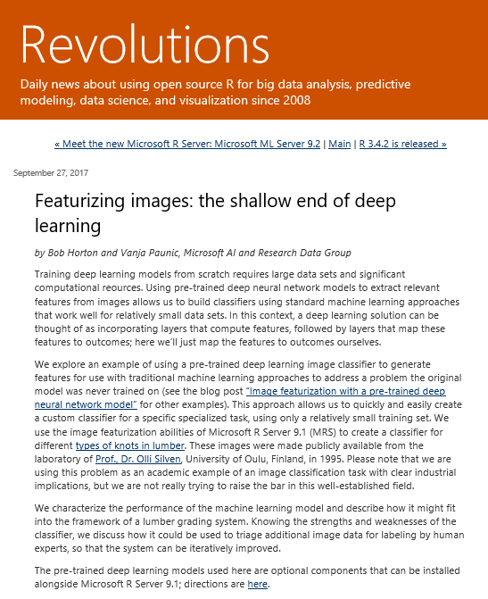
Featurizing images: the shallow end of deep learning
http://blog.revolutionanalytics.com/2017/09/wood-knots.html

Slide 5
Domain: Wood Knots and Lumber Grading
In the sawmill industry lumber grading is an important step of the manufacturing process.
Improved grading accuracy and better control of quality variation in production leads directly to improved profits.
Grading has traditionally been done by visual inspection, in which a (human) grader marks each piece of lumber as it leaves the mill, according to a factors like size, category, and position of knots, cracks, species of tree, etc.
A number of automated lumber grading systems have been developed which aim to improve the accuracy and the efficiency of lumber grading.
Notes:
In the sawmill industry lumber grading is an important step of the manufacturing process. Improved grading accuracy and better control of quality variation in production leads directly to improved profits. Grading has traditionally been done by visual inspection, in which a (human) grader marks each piece of lumber as it leaves the mill, according to a factors like size, category, and position of knots, cracks, species of tree, etc. Visual inspection is often an error prone and laborious task. Certain defect classes may be difficult to distinguish, even for a human expert. To that end, a number of automated lumber grading systems have been developed which aim to improve the accuracy and the efficiency of lumber grading.

Slide 6
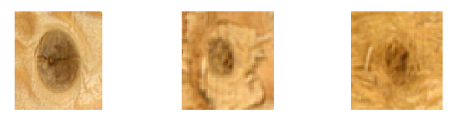
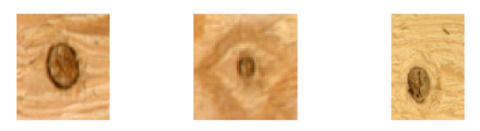
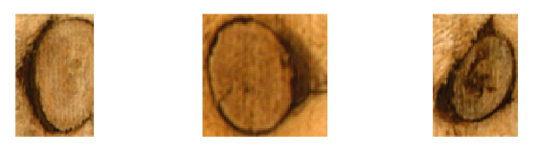
Types of wood knots
Sound knot: A knot grown firmly into the surrounding wood material and does not contain any bark or signs of decay. The color may be very close to the color of sound wood.
Dry knot: A firm or partially firm knot, and has not taken part to the vital processes of growing wood, and does not contain any bark or signs of decay. The color is usually darker than the color of sound wood, and a thin dark ring or a partial ring surrounds the knot.
Encased knot: A knot surrounded totally or partially by a bark ring. Compared to dry knot, the ring around the knot is thicker.

Slide 7
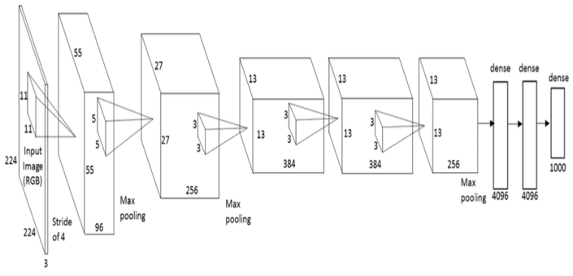
Image Featurization in Microsoft ML Server
Starting with Microsoft R Server 9.1, the MicrosoftML package has added support for pre-trained deep neural network models for image featurization.
We can now use the following four deep neural network models trained on ImageNet data set to extract features from images.
ResNet-18
ResNet-50
ResNet-101
AlexNet
Output features
Input image

Slide 8
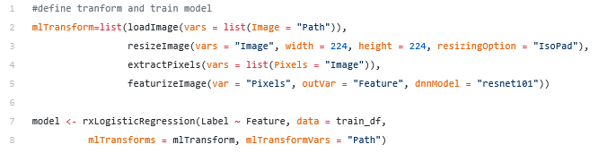
Image Featurization in Microsoft ML Server
Usage of these pre-trained models allows us to take advantage of their features hard learned from previous data sets which would be otherwise impossible or very inefficient to feature engineer.
Heuristically, the larger the model, the better the performance but the longer it takes to run.
* Code snapshot taken from https://blogs.msdn.microsoft.com/mlserver/2017/04/12/image-featurization-with-a-pre-trained-deep-neural-network-model/

Slide 9
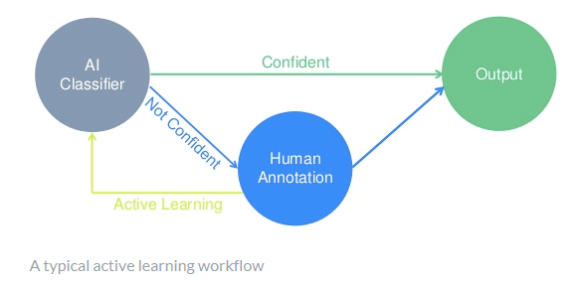
Active Learning
Active learning is a case of semi-supervised learning in which an algorithm interactively asks for additional labeled data that would result in most gain in model performance
Data (unlabeled) is often easier to come by than expert labelers
Active learning starts with a base classifier and looks for which samples should I get more of to improve my classifier the most?
What is the model good at? What needs work (e.g., more training data)?
How much of the unlabeled data can we eliminate as already identifiable?
* Image taken from https://www.crowdflower.com
Notes:
Data is often easier to come by than expert labels
Use the preliminary model for triage of unlabeled data
What is the model good at? What needs work (e.g., more training data)?
How much of the unlabeled data can we eliminate as already identifiable?
Better model -> better triage -> better selection of cases to label -> better model -> ...
Companies like CrowdFlower and services like the Custom Vision Service use active learning.

Slide 10
Active learning
In some applications, data is expensive to collect, e. g. experiments in biology
Active learning aims to to improve the model by selecting smallest data set possible in a more target way
Better model -> better triage -> better selection of cases to label -> better model -> ...
Companies like CrowdFlower and services like the Custom Vision Service use active learning.

Slide 11
Query strategies
Some of the algorithms for determining which data points should be labeled are*:
Uncertainty sampling: label those points for which the current model is least certain as to what the correct output should be
Query by committee: a variety of models are trained on the current labeled data, and vote on the output for unlabeled data; label those points for which the "committee" disagrees the most
Expected error reduction: label those points that would most reduce the model's generalization error
Variance reduction: label those points that would minimize output variance, which is one of the components of error
* Source: https://en.wikipedia.org/wiki/Active_learning_(machine_learning)

Slide 12
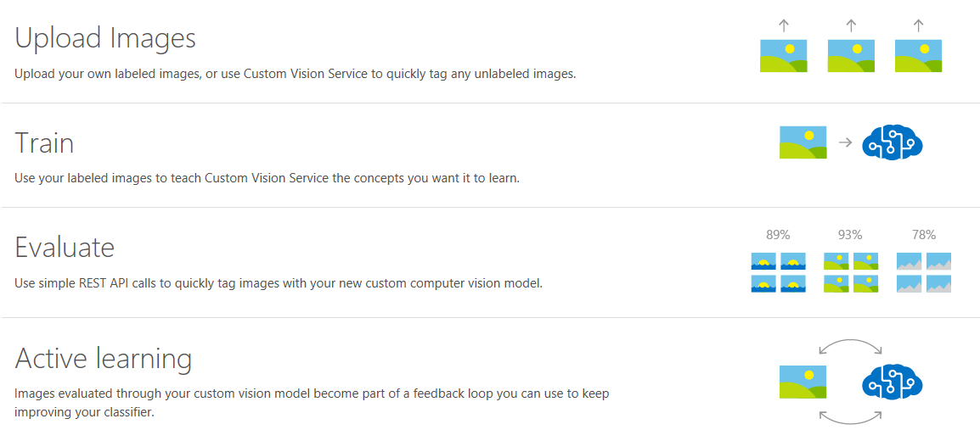
Custom Vision Service on Azure
Easily customize state-of-the-art computer vision models for your unique use case. Just upload a few labeled images and let Custom Vision Service do the rest.

